Slide 1
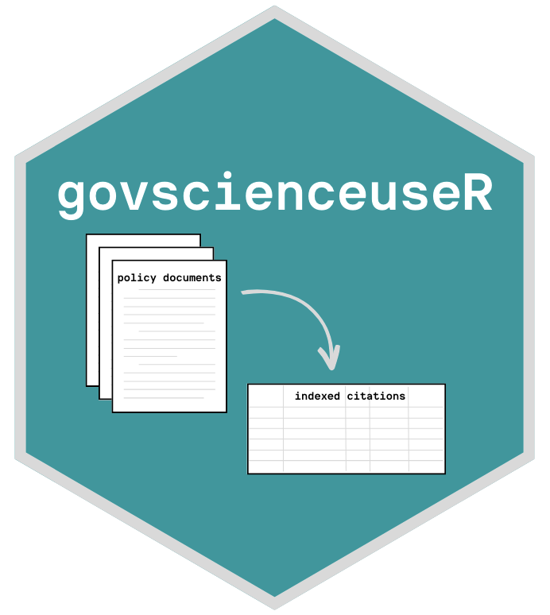
govscienceuseR: Tools for quantifying science in policy
Liza Wood
Tyler Scott
University of California, Davis

Slide 2
Policymakers should ‘listen to the science’
Goal: Align scientific supply & demand between researchers and policymakers (Sarewitz & Pielke 2007)
Challenges / caveats:
‘Science’ is not value-free (Sarewitz 2000)
Requires problem framing and persuasion of particular actors (Cairney et al. 2016)
Reliant on boundary spanners to bridge languages (Guston 2001)
Knowledge extends beyond ‘science’ (Vigar 2017)
Notes:
So let’s get into motivation. There’s a sentiment echoed a lot by government:
Academics at the science-policy interface have contended that indeed they should, and that there should be an effort on
Of course, there are challenges

Slide 3
Policymakers should ‘listen to the science’
But how do we measure science in policy?
Goal: Align scientific supply & demand between researchers and policymakers (Sarewitz & Pielke 2007)
Interviews: Policymakers self-report neutrality regarding research use (Newman et al. 2016; Piczak et al. 2022)
Manual assessments of documents: Disconnect between supply & demand; reliance on governmental resources (Koontz 2022, Desmaris and Herd 2014)
Challenges / caveats:
‘Science’ is not value-free (Sarewitz 2000)
Requires problem framing and persuasion of particular actors (Cairney et al. 2016)
Reliant on boundary spanners to bridge languages (Guston 2001)
Knowledge extends beyond ‘science’ (Vigar 2017)
toolkit for indexing & summarizing policy document references
Notes:
With all of these challenges in mind, if we wanted to measure scientific use in policy, how would we do it?
Some have used interviews with policymakers
Others, which interest us today, have manually assessed policy documents.
On the scale of tens or a hundred documents, indexing a little over a thousand reference
This is a tedious task – no uniformity and often referencing non-indexed works. Meaning, there isn’t a database like Web of Science to necessarily match them against.
So, what we set out to do is develop a computational toolkit for indexing and summarizing references in policy documents, which would allow us to analyze large bodies of text. And today we are going to give an example of how it works

Slide 4
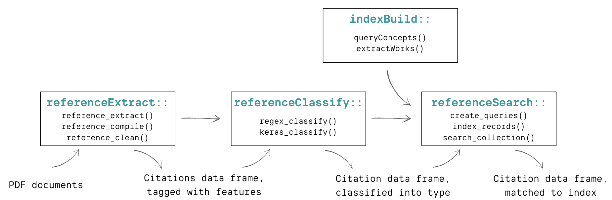
2
Notes:
This presentation is going to be very much about the process of this toolkit, and we’re going to follow this workflow diagram using an example.
So, we’ve created this toolkit called govscienceuseR, which is a collection of 4 packages built in the R programming language.
Even in this really beta phase they are open access and available on github.
So, the 4 steps:
1. the first thing we need is a set of PDF documents, and we feed them into a couple steps in the referenceextract package to get an output of a data frame of probable citations, tagged with features like jourbal name, author.
2. But, these are far from perfect bibliometric data, so next in referenceclassify we clean them up and see if we can’t find some high-level matches based on journal and agency names
3. Then we have this coarse idea of what the reference are, but still not exactly. So we build an index of potential matches in indexbuild and then..
4. query our potential citations to the index using referencesearch, and ideally get out a data frame with citations matched exactly to an indexed reference

Slide 5
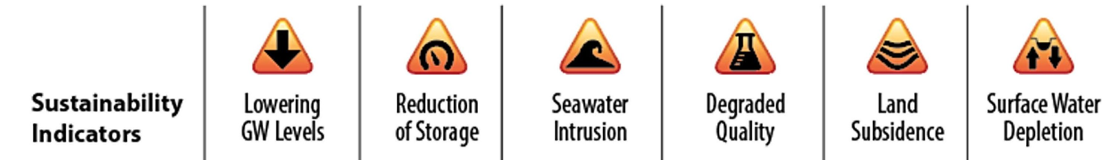
Example case: Groundwater Sustainability Plans (GSPs)
Climate change projections
Hydrology & geology
Groundwater-reliant
industry
Drinking-water
users
Infrastructure &
innovation
Decision-making
Environmental justice
Water law
How is science used to inform the multiple
dimensions of groundwater sustainability?
(Bostic et al. 2020)
Notes:
California’s Sustainable Groundwater Management Act (SGMA) of 2014 sets out a framework for local Groundwater Sustainability Agencies (‘Agencies’) to work towards sustainable management of their groundwater basins through groundwater sustainability plants, GSPs.
Among the criteria for plan evaluation, the California Code specifies that the plans need to be ‘supported by the best available information and best available science” (23 CCR § 355.4).
Clearly they need to ‘use science to define sustainability;’ but defining and measuring sustainability is no simple feat (Kuhlman & Farrington 2010).
DWR sets out six sustainability indicators as a guide, but agencies are responsible for balancing this across multiple beneficial uses: ‘domestic, municipal, agricultural, and industrial supply, among many others”
These beneficial uses start pointing to many layers of what sustainability can include:
CC & hydro
Also groundwater reliant industry
Decision-making, EJ, water late
Work by Bostic Dobbin and other colleagues looking at draft plans outline that GSPs preference some stakeholders’ sustainability over others
Facing the challenge of managing groundwater resources across a wide array of users and interests, we ask:
How is science used to inform the multiple dimensions of groundwater sustainability?

Slide 6
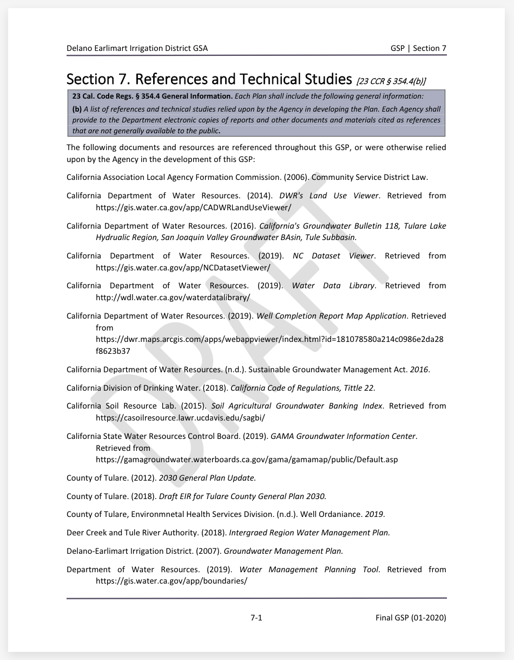
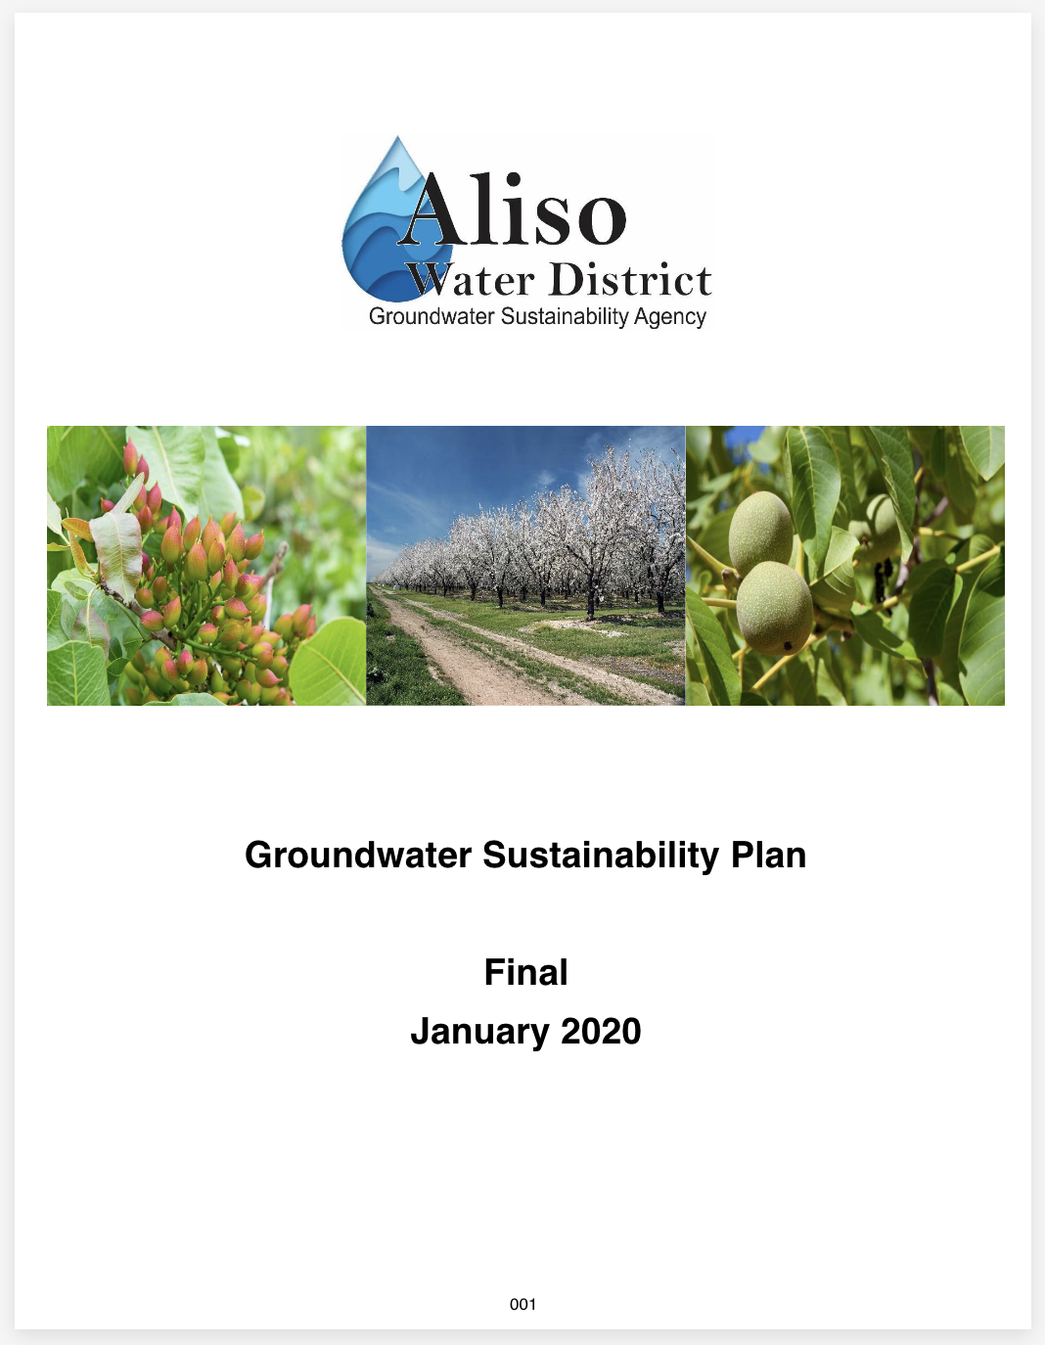
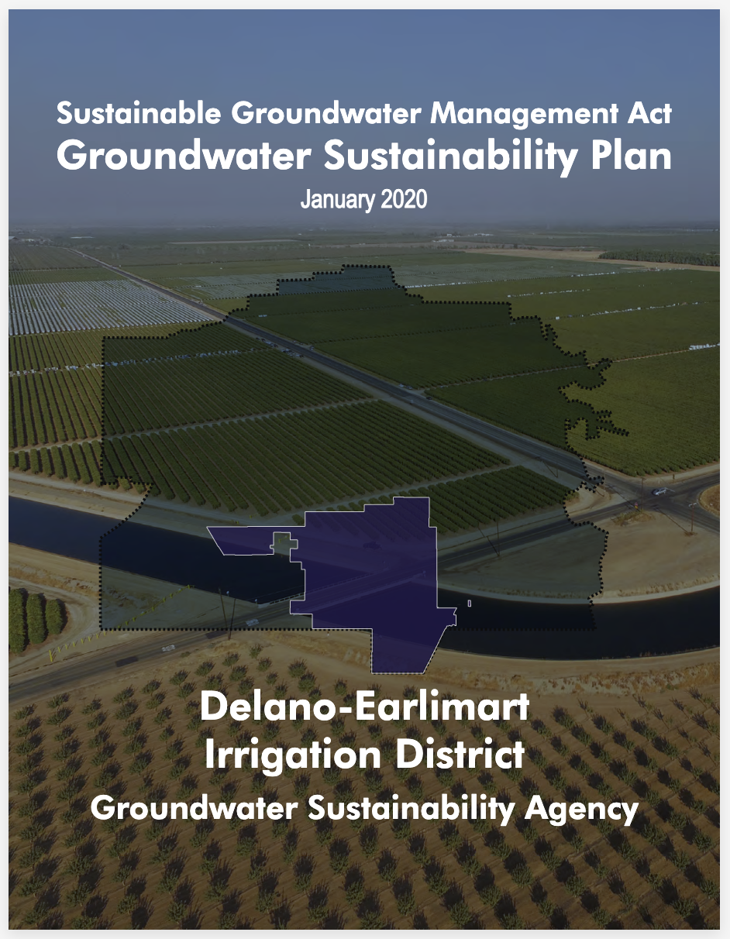
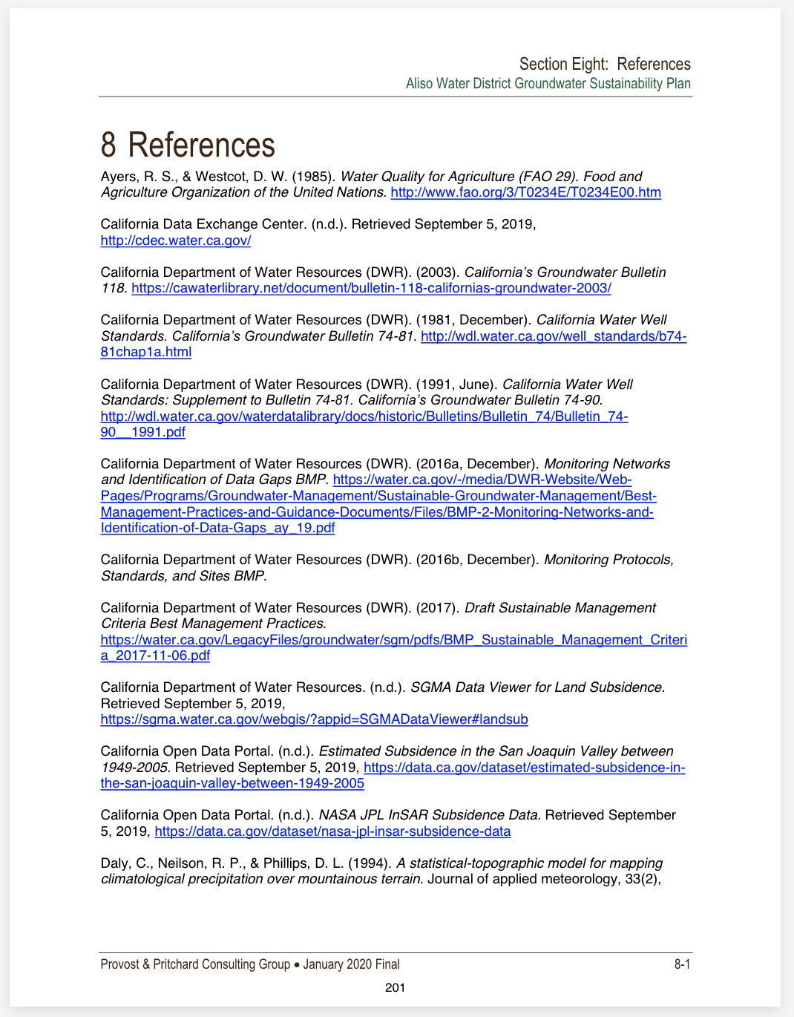
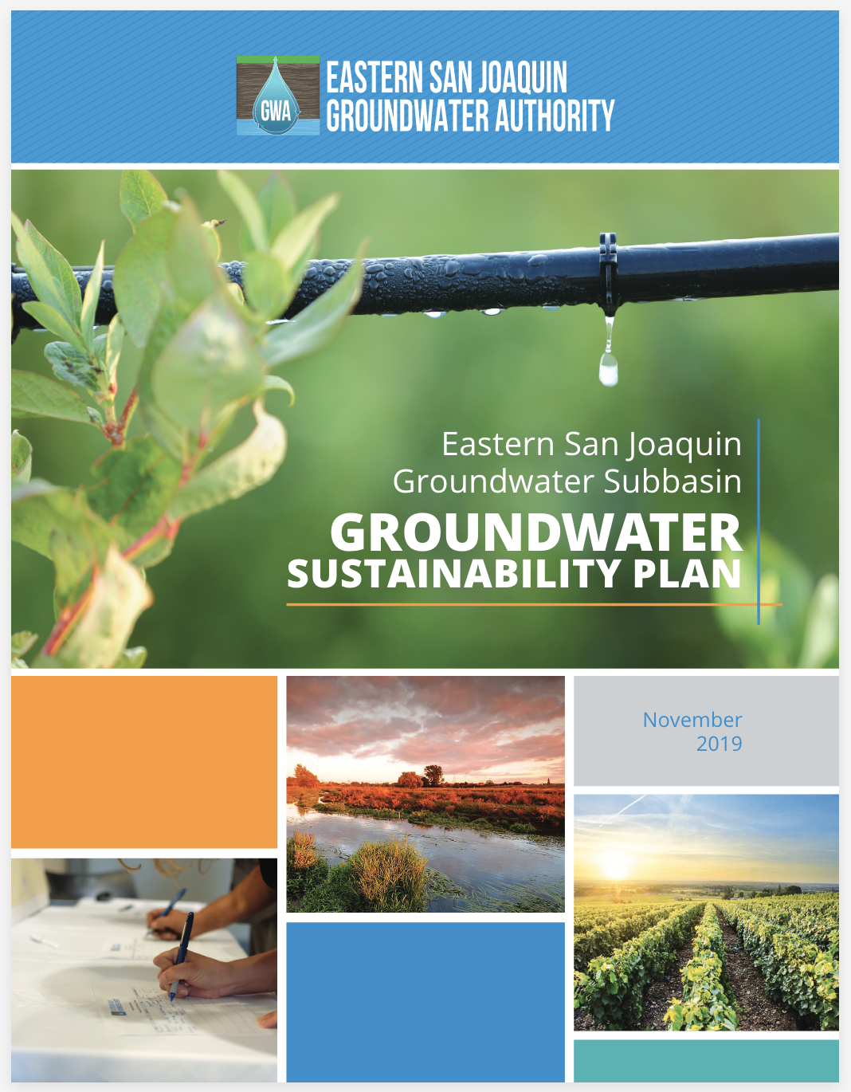
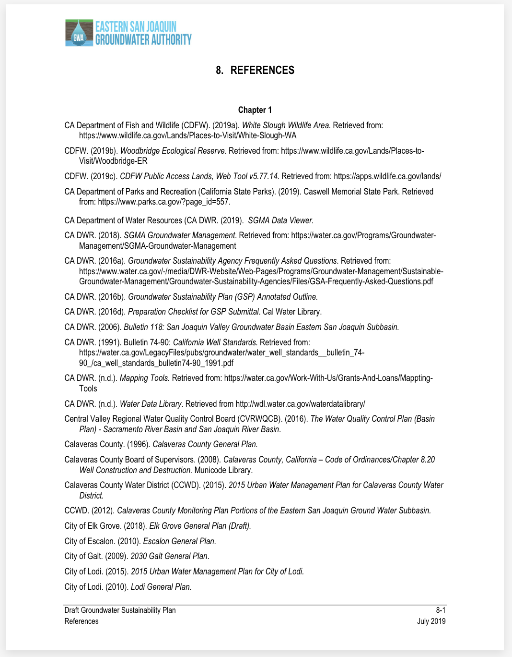
Example case: Groundwater Sustainability Plans (GSPs)
…
114 documents
160K+ pages

Slide 7
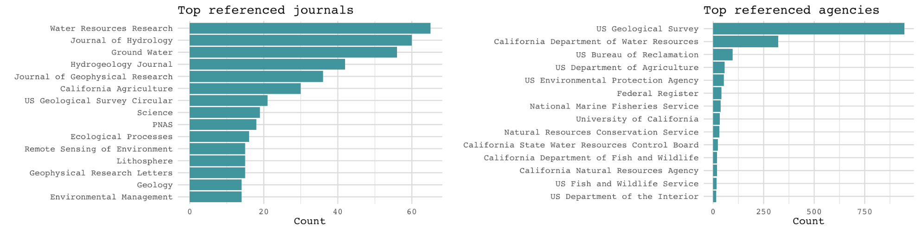
114 documents
~160K pages
~14K probable
references
1,856 journal refs
3,675 agency refs
Notes:
1800 journal refs and 3600 agency refs
These are not yet indexed exactly, but they have been identified at these coarse levels, so let’s take a look at what jumps out
Agencies: reliance on USGS and DWR, the enforcement agency of these plans, and then a long tail of agencies, typically at the federal and state level
Journals: The top 15 here are I think all natural science journals, and are pretty close to that top layer we mentioned: hydrology and geology
These kinds of results bring up questions like: other than discipline what are the shared features of the references that get used?
High impact or low impact? New or old?

Slide 8
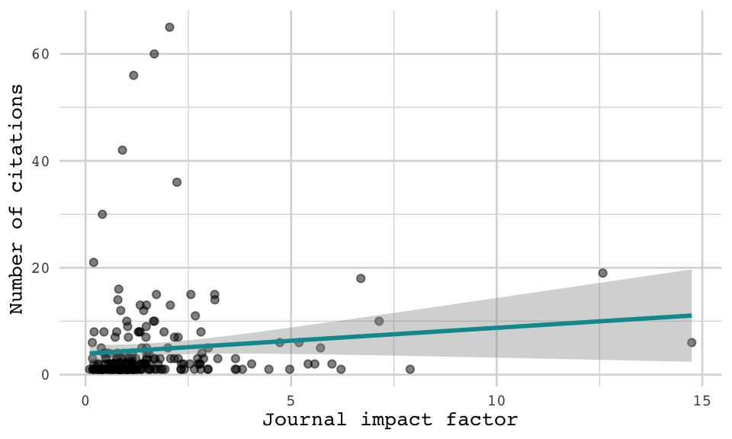
114 documents
~160K pages
~14K probable
references
1,856 journal refs
3,675 agency refs
Notes:
And our tool can help because we can link these journals names to journal-level metadata, like impact factor
[this image]
Our research has found, for these documents and others, that high impact is really not so important for policy references. Instead, the highest-cited journals are specialized to the domain and/or technical/applied journals.
What about age?

Slide 9
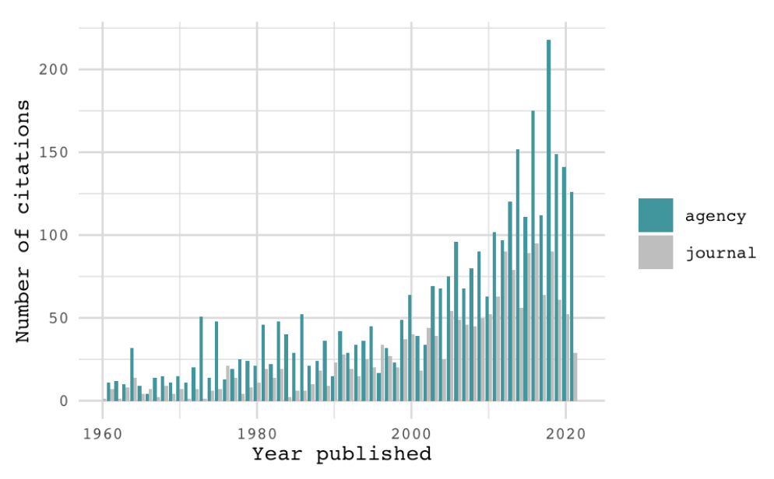
114 documents
~160K pages
~14K probable
references
1,856 journal refs
3,675 agency refs
Notes:
Also, it takes time to get your science heard
Plot of year published and counts of citations
Mean age of references is around 20 years old, median about 14 so the most commonly cited referenced are from somewhere between 2001-2008.

Slide 10
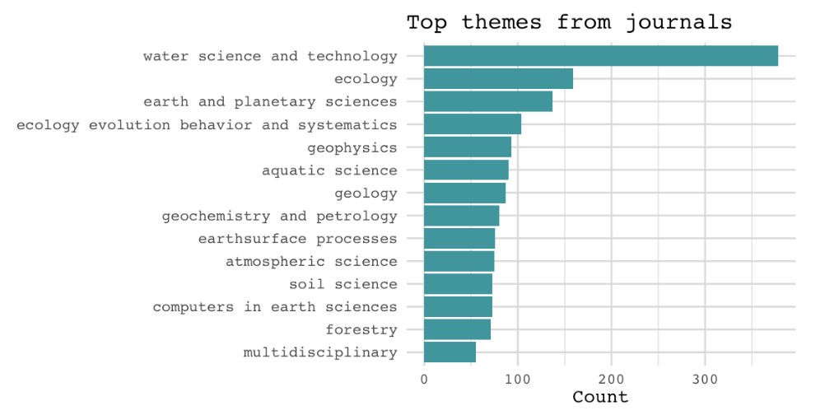
197 journal themes -> 3,982 concepts -> [n-million works]
[need a governmental index]
114 documents
~160K pages
~14K probable
references
1,856 journal refs
3,675 agency refs
Draft index: 630K political science works (2000-2003)
doi | title | year | journal_title | authors
https://doi.org/10.1037//0003-066x.55.1.68 | Self-determination theory and the facilitation of intrinsic motivation, social development, and well-being. | 2000 | American Psychologist | Richard M. Ryan;Edward L. Deci
https://doi.org/10.1146/annurev.soc.26.1.611 | Framing Processes and Social Movements: An Overview and Assessment | 2000 | Annual Review of Sociology | Robert D. Benford;David A. Snow
https://doi.org/10.1016/s0048-7333(99)00055-4 | The dynamics of innovation: from National Systems and “Mode 2” to a Triple Helix of university–industry–government relations | 2000 | Research Policy | Henry Etzkowitz;Loet Leydesdorff
https://doi.org/10.2307/2586011 | Increasing Returns, Path Dependence, and the Study of Politics | 2000 | American Political Science Review | Paul Pierson
Notes:
But so far, these results are not exact. They are based on a pretty coarse level: we can see things like agency and journal name, so we can’t know any more about it than what journal-level metadata can tell us.
So, we want to dig deeper by matching our probable references to an index. This is where index build comes in
We can take the themes from journal metadata: for instance here are the top themes from the journals we saw
Then we rely on openAlex software to link these themes to what they call concepts, and then build out an index. Or basically, a giant list of journals. This is where our vignette stops a bit, because building these indices take time –
We’re talking in the tens of millions of works
But we can a little example…
So here is just an extract from a draft index, which are political science works between 2000-2003, of which there are 630K

Slide 11
197 journal themes -> 3,982 concepts -> [n-million works]
[need a governmental index]
114 documents
~160K pages
~14K probable
references
1,856 journal refs
3,675 agency refs
[n indexed refs]
In progress
An example of the indexing process:
Input:
Potential
ref
doi | title | authors | year | journal_title
NA | Development of a Threedimensional Model of Sedimentary Texture in Valleyfill Deposits of Central Valley | Faunt, CC; Belitz, K; Hanson, RT; Survey, Geological | 2010 | Hydrogeology Journal
doi | title | authors | year | journal_title | score
10.1007/pl00021536 | An ecosystem approach to planning for groundwater: The case of Waterloo Region, Ontario, Canada | D. A. Neufeld | 2000 | Hydrogeology Journal | 7.2
10.1007/s100400100156 | Hydrogeologic studies for nuclear-waste disposal in Sweden | Douglas D. Walker;Björn Gylling;Anders Ström;Jan-Olof Selroos | 2001 | Hydrogeology Journal | 7.2
10.1007/s10040-002-0203-y | Towards a policy for sustainable use of groundwater by non-governmental organisations in Afghanistan | David Banks;Oddmund Soldal | 2002 | Hydrogeology Journal | 7.2
Output:
Match options & scores
Notes:
And what this last stage, referencesearch, does, is it looks at our probable citations against these massive indices, and tried to identify matches and provide a score of how good that match is
Let’s take an example:
We input a potential reference. It looks like this, but isn’t perfect. No DOI, a title with some weird formatting, a list of authors but also Geological survey thrown into there… but it has a journal name
When we input this into referencesearch, we ask it for the top 3 matches and we get these: 3 indexed citations that maybe match… but their score is very low. This is out of 100, I think.
And now, this is in part because our index hasn’t been built up to 2010 yet, so what the tool tried to do was say… here are things with at least the same journal name. They’re not great matches, BUT, this is example I could offer at the moment
But so iterating across every potential citation and pulling out high match scores would help us get out final indexed reference list.

Slide 12
How is science used to inform the multiple dimensions of groundwater sustainability?
Next steps
Preliminarily: documents average…
24 citations
32 to agencies
16 to academic journals
20 year-old citations
Journals
1.9 SJR impact factor
(Science = 12.6)
92 disciplinary themes, largely in natural science
[Deeper article-based investigations forthcoming]
Tool improvements:
Developing index defaults
Wide-net openAlex index
Government index?
Improving matching decisions
Building out article text extraction (open-access) and analysis (e.g. topic modelling)
Collaborations:
Add document metadata for domain-specific questions (e.g. GSA composition, #DAC, overdraft level)
Diversifying policy domains

Slide 13
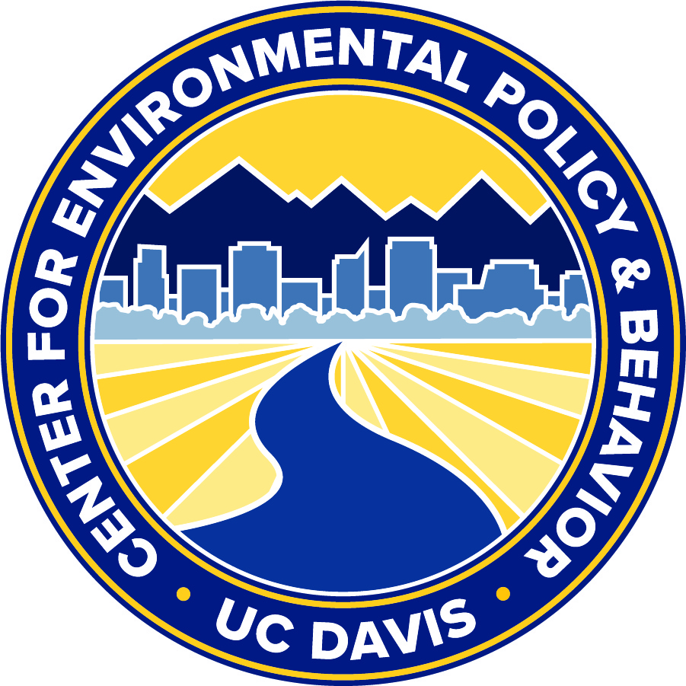

govscienceuser.github.io/
Liza Wood
Tyler Scott
University of California, Davis

